Slide 1
Weekcode
Week 5: The 5 Error Problem, The Implementation Problem, and the Reverse Pair Problem

Slide 2
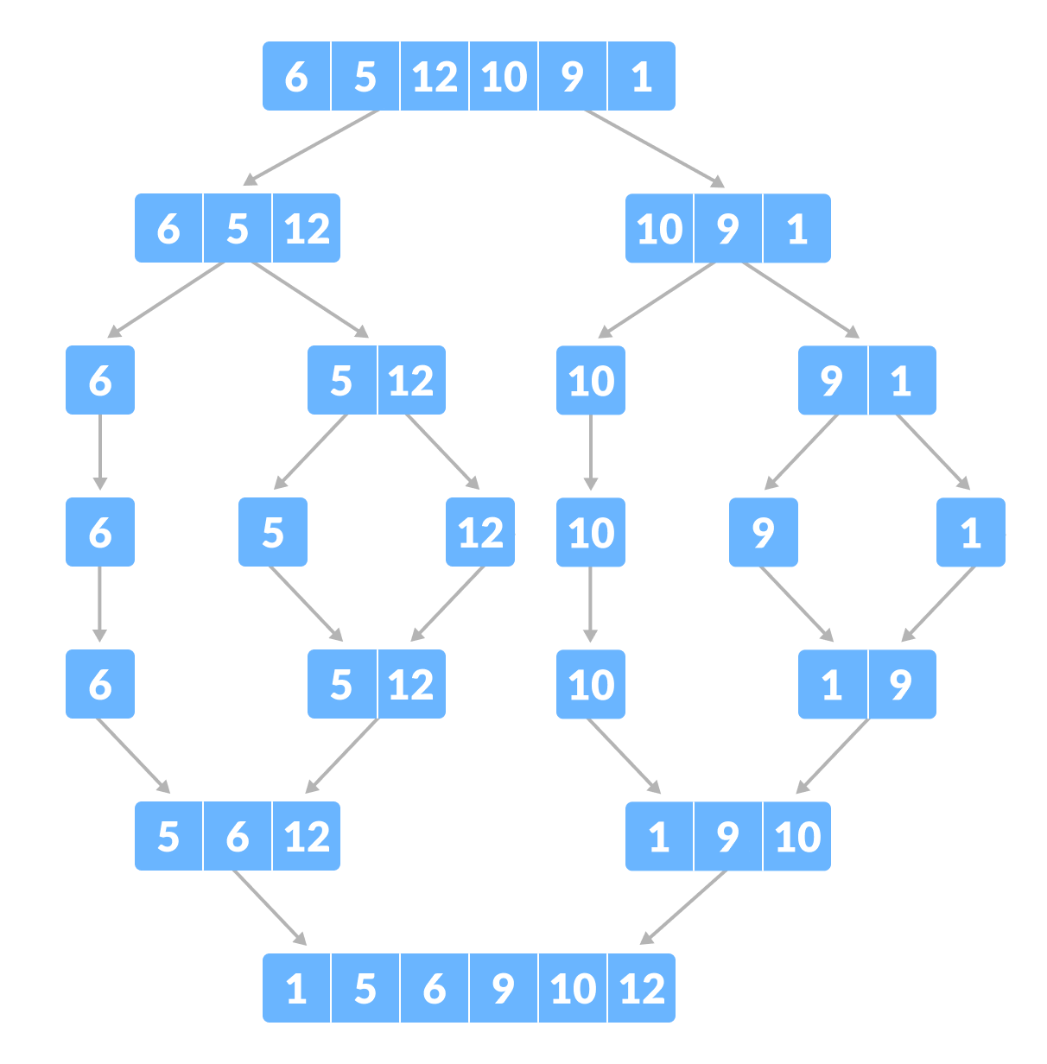
This week’s DSA concept:
Mergesort

Slide 3
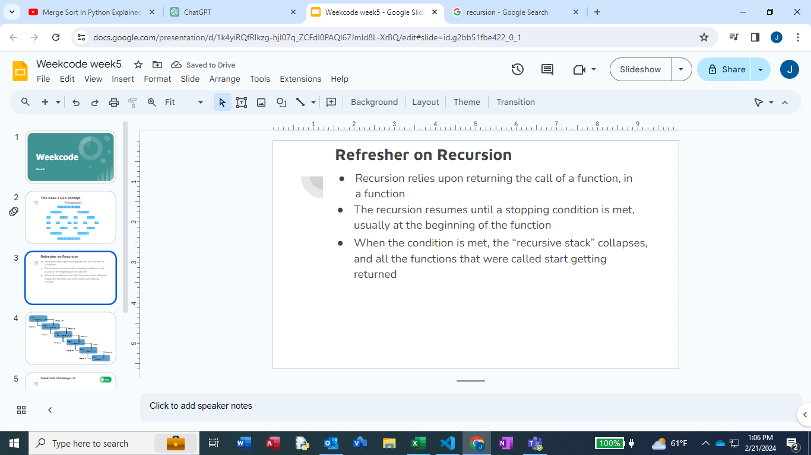

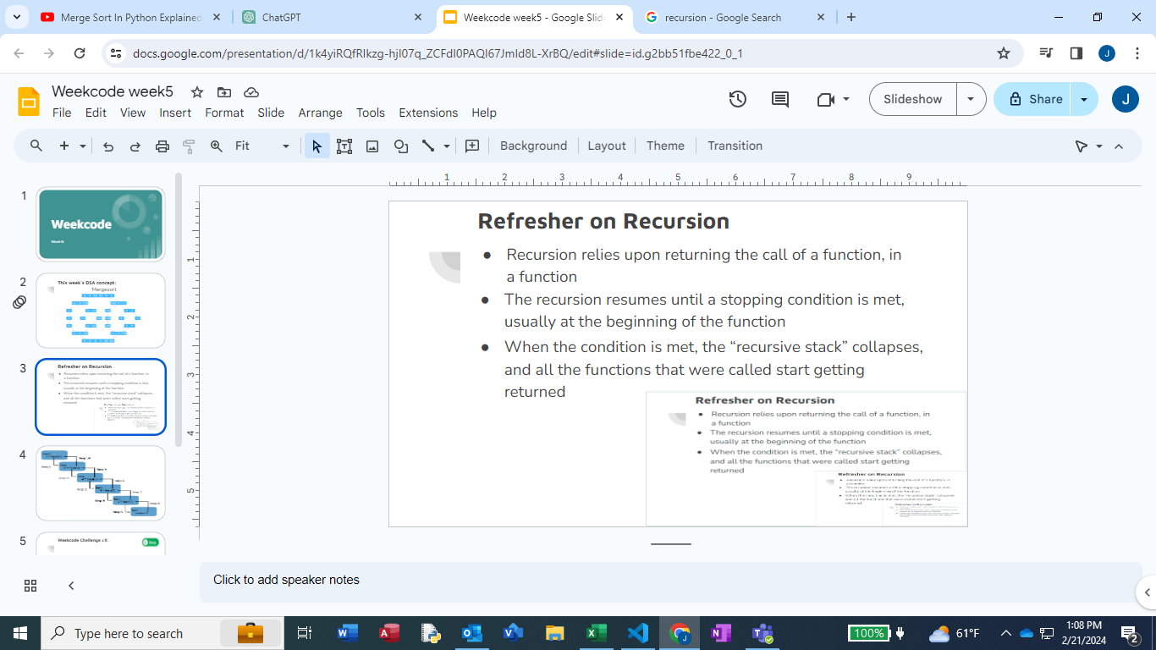
Refresher on Recursion
Recursion relies upon returning the call of a function, in a function
The recursion resumes until a stopping condition is met, usually at the beginning of the function
When the condition is met, the “recursive stack” collapses, and all the functions that were called start getting returned

Slide 4
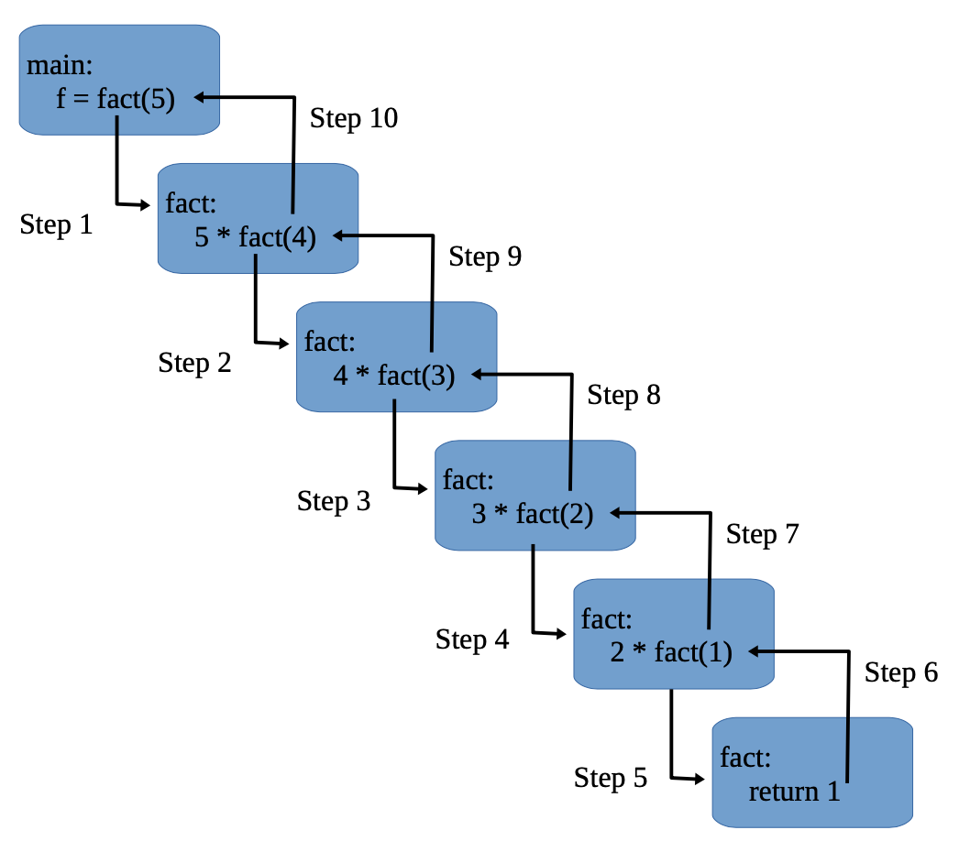

Slide 5
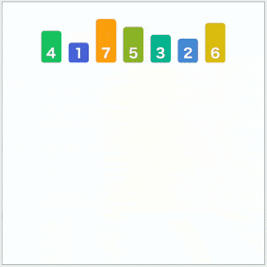
Introduction to Mergesort
Sorting Algorithm
“Divide and Conquer” Algorithm
Great for sorting large data sets
Almost always implemented via recursion
O(n log n)

Slide 6
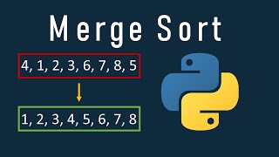
Mergesort steps in a nutshell
1) Slice: Cut all elements in the list into individual arrays
2) Sort: Organize the elements by value
3) Merge: Put it all together again
4) Repeat: Repeat until break case is reached (in recursion)

Slide 7

Weekcode Challenge #7:
The 5 Errors Problem
You are given a .py file that tries to attempt Mergesort. However, 5 logical errors exist that prevent the code from compiling. You must identify the 5 logical errors and fix them. Further clarification exists in the code.
This problem can only be attempted by pulling the “easyBOILERPLATE.py” file from the week5 folder on the Weekcode GitHub (which is easily accessible from our Discord server)

Slide 8
Weekcode Challenge #8:
The Implementation Problem
Given an array of integers nums, sort the array in ascending order and return it. You must solve the problem without using any built-in functions in O(nlog(n)) time complexity and with the smallest space complexity possible.
Input: nums = [5,2,3,1]
Output: [1,2,3,5]
Explanation: After sorting the array, the positions of some numbers are not changed (for example, 2 and 3), while the positions of other numbers are changed (for example, 1 and 5).

Slide 9
Weekcode Challenge #9:
The Reverse Pairs Problem
Given an integer array nums, return the number of reverse pairs in the array.
A reverse pair is a pair (i, j) where:
0 <= i < j < nums.length
nums[i] > 2 * nums[j]
Input: nums = [1,3,2,3,1]
Output: 2
Explanation: The reverse pairs are:
(1, 4) --> nums[1] = 3, nums[4] = 1, 3 > 2 * 1
(3, 4) --> nums[3] = 3, nums[4] = 1, 3 > 2 * 1
Input: nums = [2,4,3,5,1]
Output: 3
Explanation: The reverse pairs are:
(1, 4) --> nums[1] = 4, nums[4] = 1, 4 > 2 * 1
(2, 4) --> nums[2] = 3, nums[4] = 1, 3 > 2 * 1
(3, 4) --> nums[3] = 5, nums[4] = 1, 5 > 2 * 1

Slide 10

Looking Ahead
Good Luck! More Challenges next week!
Make sure you get boilerplate/example code from the GitHub!

